Slide 1

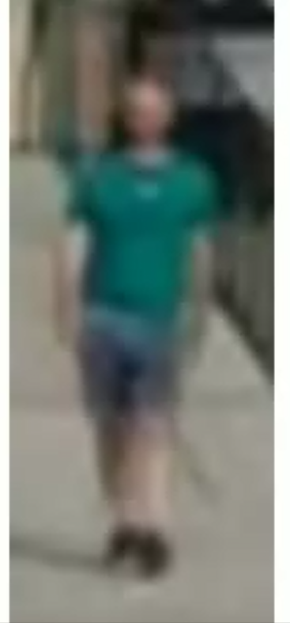
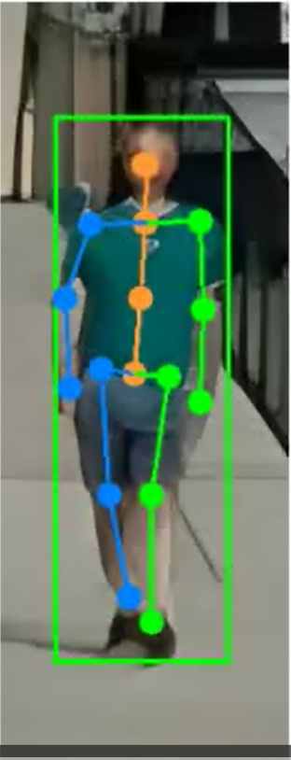
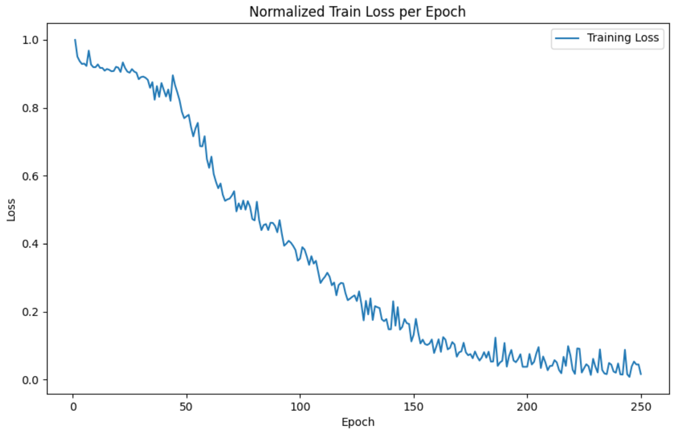
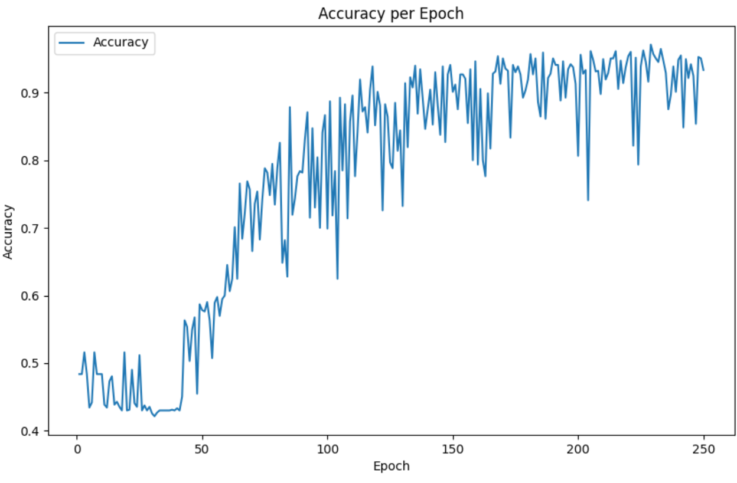
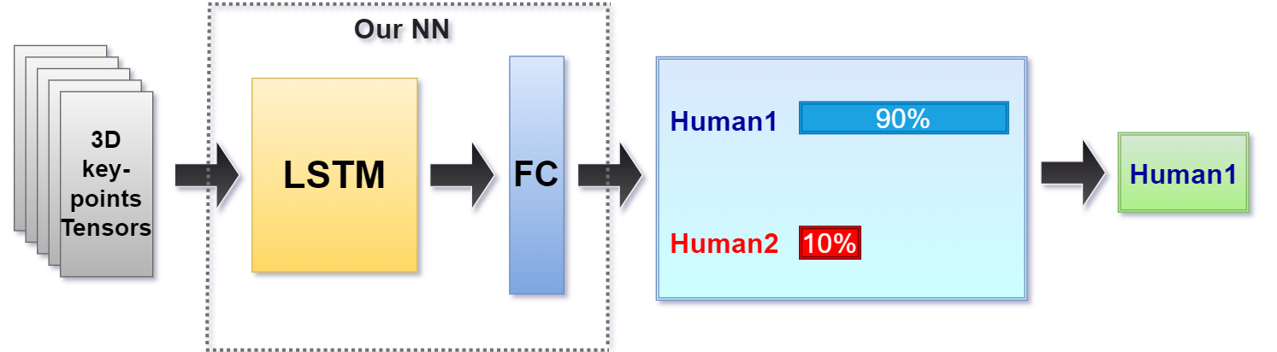
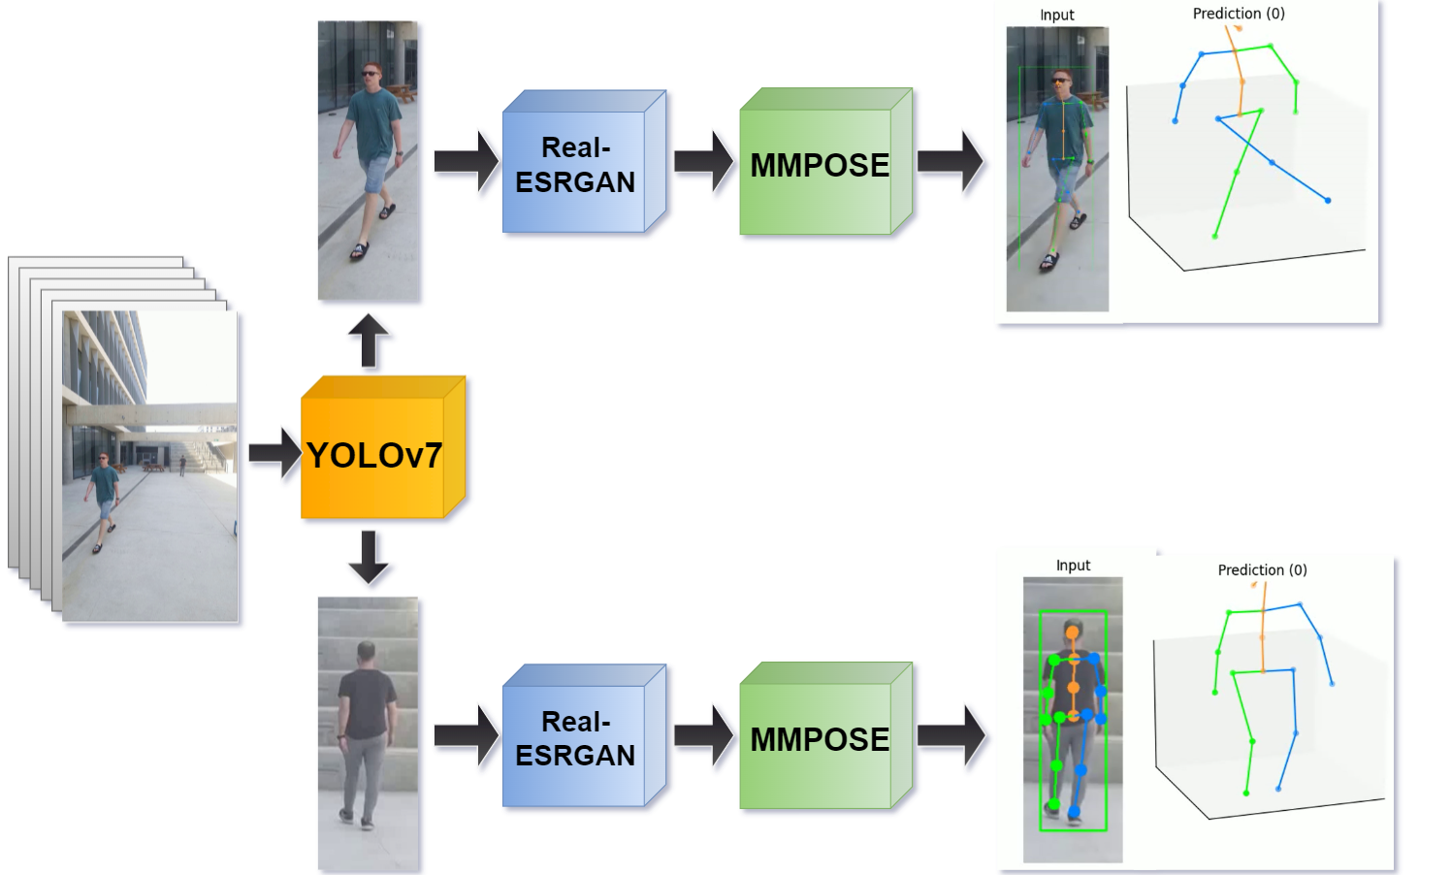
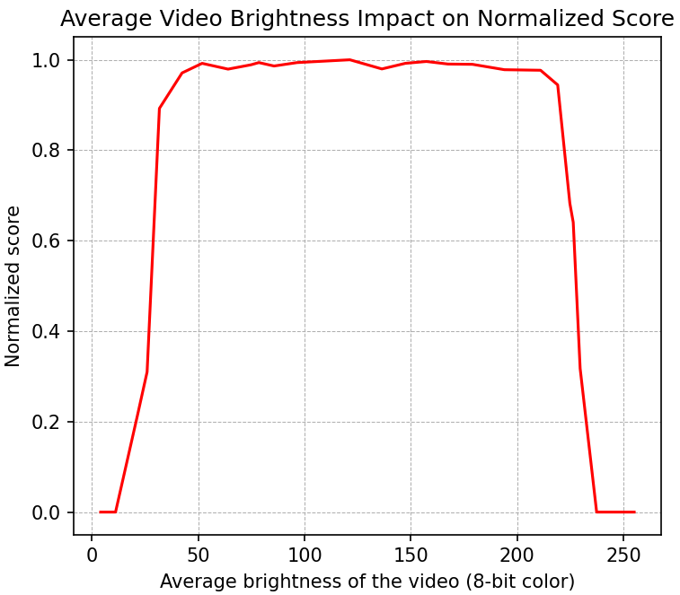
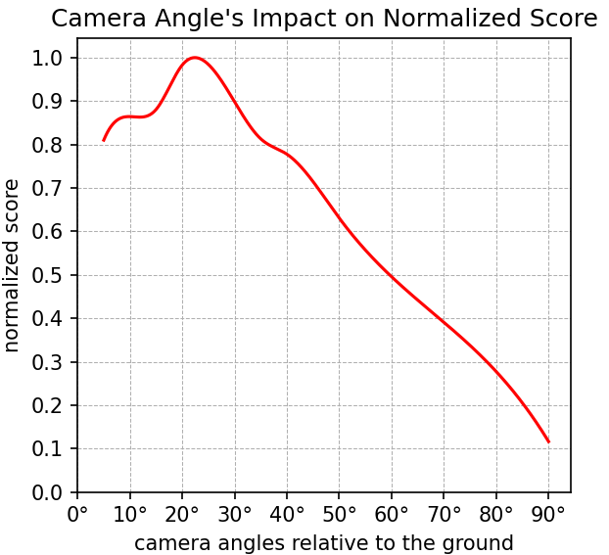
Enhancement method of Gait Recognition
Project Number: 22-1-1-2565
Names: Ofir Solomon, Yonatan Rosin
Advisor: Khen Cohen
Introduction Gait recognition is a significant area of research in computer vision and biometrics, it is focused on the analysis and identification of human walking patterns, with its potential applications in security systems, surveillance, healthcare, and forensic investigations. Our work aims to demonstrate the feasibility of classifying individuals based on their human-shape and walking pattern. Objectives In our work, we present an alternative method for acquiring skeleton points on individuals, aiming to enhance the stability of data point collection. Our objective is to explore the efficacy of this new method across various scenarios, including recording from different angles, varying distances, and diverse lighting conditions. By assembling an extensive dataset of skeleton points at different time intervals, we endeavor to establish a proof of concept to ascertain whether these points can be utilized to accurately capture gait patterns and successfully distinguish between two distinct individuals. Implementation - The video processing pipeline was established to generate a stable and accurate skeletal output: | • First, Object detection using the YOLOv7 [1] model: The video is processed through an object detection model, YOLOv7, which identifies humans in each frame. • Super-resolution with Real-ESRGAN [2]: The detected individuals are extracted and passed through the Real-ESRGAN super-resolution model. This model increases the pixel count of the target person, enhancing detection accuracy in the subsequent block. • Conversion to spatial joint representation with MMPOSE [3]: The main block, MMPOSE, takes the enhanced image and converts the person in the image into a spatial representation of their joints. This step enables further analysis and understanding of human movement and poses. - We utilized the skeleton tensors obtained from the pipeline and fed them into a LSTM-based classification network. The primary objective of this network was to determine the feasibility of distinguishing between two individuals: The loss function we used was: $$l_{n}=−w_{n} [y_{n}∙log⁡(σ(x_{n})+(1−y_{n})∙log⁡(1−σ(x_{n}))]$$ Results In the following graphs we examined how the skeleton was detected in our pipeline under different conditions: | In the following images, the original MMPOSE (a) failed to place skeleton, while SR (b) improved the detection ability significantly: (a) (b) At last, the subsequent graphs illustrate the outcomes of the LSTM-based classification network: Conclusions It was observed that the pipeline yields successful results under normal lighting circumstances, while the angle of the capture in relation to the ground plays a crucial role. The ideal angles for optimal output ranges around 20°. Furthermore, the POC conducted on classifying two distinct individuals demonstrated a viable ability to differentiate between them with significant accuracy based on their human-shape and walking pattern. Bibliography [1] C.Y. Wang, A. Bochkovskiy, H.Y.M. Liao., "YOLOv7: Trainable bag-of-freebies sets new state-of-the-art for real-time object detectors", July 2022 [2] X. Wang, L. Xie, C. Dong, Y. Shan, "Real-ESRGAN: Training Real-World Blind Super-Resolution With Pure Synthetic Data", 2021 [3] MMPose Contributors. "MMPose: Open-Source Library for Human Pose Estimation.” https://mmpose.readthedocs.io/en/v0.29.0/demo.html#id10

